Slide 1



Evolution of the Site of Care:
Provider, Payer and Patient Perspectives
  Dan Henderson, MD, MPH, Chief Medical Officer, instED at Commonwealth Care Alliance
  Mary Beth Irwin MPH, RPh, VP Pharmacy Services at Blue Cross Blue Shield of MA
  Matthew Cohen, Patient Advocate
Notes:
Today we have a robust agenda to share; go over each speaker and topics

Slide 2


Evolution of Site of Care:
Provider Perspective
Dan Henderson, MD, MPH
Chief Medical Officer, instED at Commonwealth Care Alliance
No disclosures; all viewpoints are my own.
Notes:
Introduce yourself
We would like to thank NELC and its Board of Directors for creating this opportunity for their member hospitals to join in a collaborative program covering a broad array of population heath and value- based care topics in the last three years.

Slide 3

Senior physician in my practice (2015)
“If a patient calls with a question that will take more than one minute to answer, bring them in for a visit.”

Slide 4

Primary Care in The Before Times
>95% face-to-face office visits
Emphasis on volume and billing
Urgent access important, but discretionary
“Virtual care” nice to have but often in conflict with productivity, work-life balance (or equity)
Patient (in)convenience = the elephant in the room

Slide 5

Pre-COVID trends and undercurrents
Aging, more medically complex population
Rising cost of care
Aging, shrinking PCP workforce – head count and FTEs
Risk shifting to “pay-viders,” health systems, providers
Increasing share of managed care - (M’Care Advantage ~48.5%)
Bull markets x low interest rates = Cheap, eager money

Slide 6

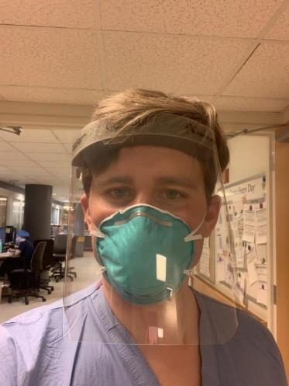
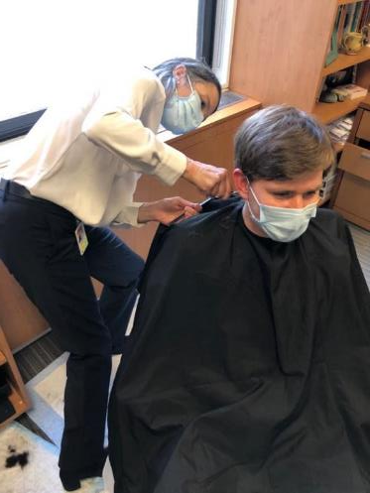
And then, COVID-19

Slide 7

Massive change 1: Telehealth
From 1-5% to 86% of visits essentially overnight
“Building the plane while in flight.”
Many challenges:
  Technical – Platform, regulations, billing
  Clinical – Problem-medium matching, creative physical examination
  Cultural – Patient attitude and comfort
  Equity of access – Overcoming the “digital divide”

Slide 8
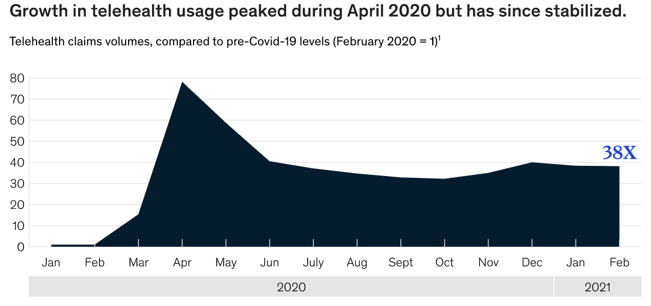
Massive change 1: Telehealth
(McKinsey and Co, 2021)

Slide 9
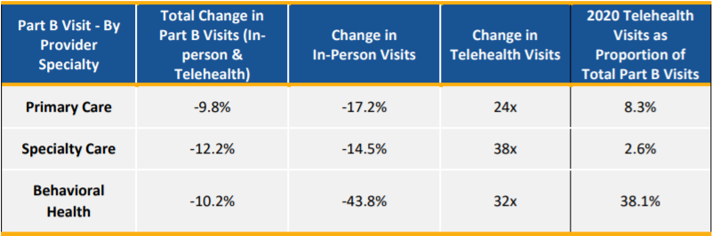
Massive change 1: Telehealth
States with most use in 2020:
MA = 10.6%
VT = 9.8%
RI = 8.9%
NH = 7.8%
MD = 7.3%
CT = 7.2%
(ASPE, 2021)

Slide 10

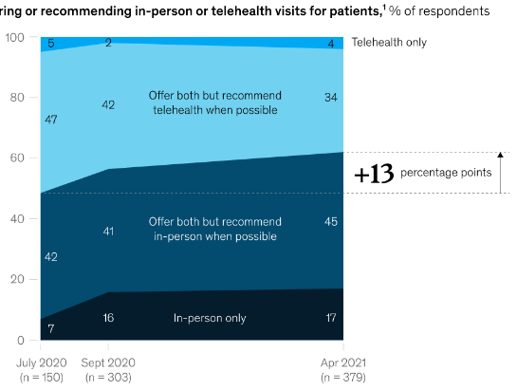
Millions of Virtual Visits Later:
Often preferred by Patients, providers
Untapped potential to reduce wait times
Vigorous innovation and growth
Access disparities real, not as bad as feared
CCA’s experience:
  66% of 20K+ surveyed virtual care-ready
  Age range of patients 22 to 104
  Over 30 languages in use
  “You have video visits!”
(McKinsey and Co, 2021)

Slide 11

Millions of Virtual Visits Later:
Remaining challenges:
  “Sorting” to virtual vs in-person care
  Long-term regulatory/payment uncertainty
  State lines and state licenses
  Pop health, empanelment, and what “counts,” in a value-based world
  Financial and logistical hurdles for practices

Slide 12
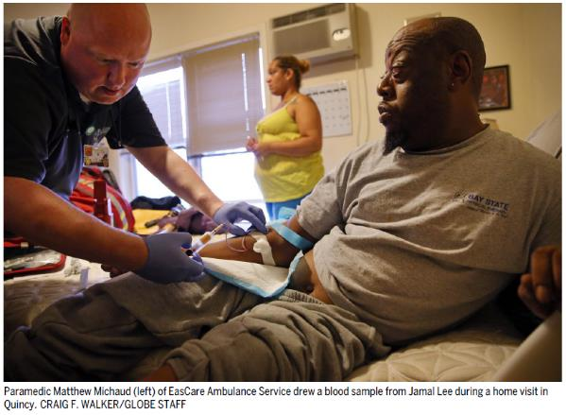
Massive change 2: In-Home Urgent Care
Two primary models:
Hospital-at-Home (H@H)
  “Admission” from ED to one’s home, with hospital-style care.
Mobile Integrated Health (MIH)
  In-home urgent care provided by paramedic, with physician-level provider supporting and supervising.
(Boston Globe, 2016)

Slide 13
Massive change 2: In-home Acute/Urgent Care
Mobile Integrated Health - urgent, unscheduled, or ED-style
Paramedics deliver in-home care, with physician present remotely via telehealth.
~85% short-term ED avoidance (3-days)
Dramatic cost savings (2-3x cost)
Preferred by patients to ED (NPS 90%+ vs <30% ED)
Valued by primary care teams

Slide 14
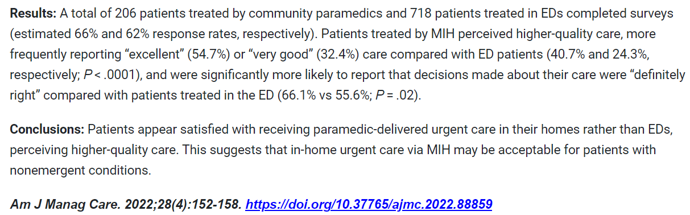

News clippings on ACCP

Slide 15
Massive change 2: In-home Acute/Urgent Care
Hospital at home –admission alternative for selected conditions and patients, with lots of wins for stakeholders:
Cost savings - ~32%
Outcomes – comfort, experience, and dramatically lower delirium incidence
Better match of acuity across continuum of sites
Infection avoidance the cherry on top
A fun new role for physicians and APCs, and target for HSRs

Slide 16





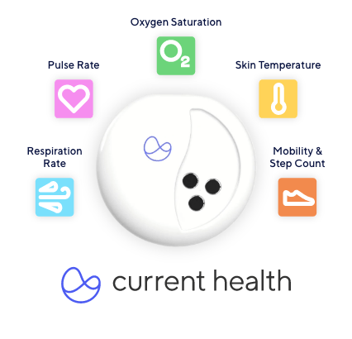
Massive change 3: Gadgets
Medminder smart pillbox
ZioXT heart rhythm monitor
FreeStyle Libre 14-day sensor
Current Health sensor
WiThings connected scale
LifePod system

Slide 17








Remote Patient Monitoring in COVID-19
Daily symptom monitoring
(14 days +/-)
Pulse oximetry for highest-risk
~250 enrolled across MGB
(April-July ‘20)
Goals
Enhance safety of discharge home.
Reduce length of stay.
Reduce patient and provider worry.
RN monitored inbasket
Red flags trigger call
Escalation to physician backup
46% reduction in ED revisit/readmission
(odds ratio 0.54, p=0.039)

Slide 18

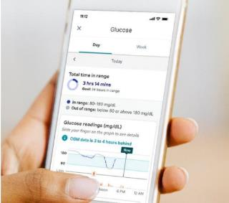
Remote Devices in Chronic Conditions Care
Remote Patient Monitoring
Digital Therapeutics
Telehealth
Coaching
Improved outcomes

Slide 19

Massive Change 4: Equity Matters

Slide 20





















Massive Change 5: Choices
More options than ever across the healthcare ecosystem
Payors (and Employers)
Providers
Patients (or “consumers”)

Slide 21

What Will Happen Next?
“The status quo is everyone’s second choice.”
- Stuart Altman, PhD

Slide 22

Happy Place Scenario

Slide 23

Scary Place Scenario

Slide 24
Thank you!

Slide 25

Evolution of Site of Care:
Payer Perspective
Mary Beth Erwin MPH, RPh
VP/Chief Pharmacy Officer
Blue Cross Blue Shield of MA
Notes:
Introduce yourself
We would like to thank NELC and its Board of Directors for creating this opportunity for their member hospitals to join in a collaborative program covering a broad array of population heath and value- based care topics in the last three years.

Slide 26




Evolution of Site of Care
2-3X
Higher cost for the same drug
and service in health system versus alternate sites*
11.5%
Expected increase in specialty drug spend in 2021 compared to 2.8% increase in non-specialty**
40%
Commercial payers requiring specialty pharmacy to supply medication to hospitals***
42%
% commercial
plans in 2018 utilizing a site of care strategy
to manage at least one condition*
*Counce, J. (2019). Home Infusion’s Expanding Role in Optimizing Site of Care.
Accessed 9/2022: https://nhia.org/documents/CE_May_June_2019.pdf
**Griffin J. Prescription drug pricing trends. JP Griffin Group. January 20, 2021. Accessed 9/2022. https://www.griffinbenefits.com/blog/prescription-drug-pricing-trends-2021
***Fein A. Specialty pharmacy keeps disrupting buy-and-bill—and COVID-19 will accelerate it. Drug Channels. September 23, 2020.Accessed 9/2022. https://www.drugchannels.net/2020/09/specialty-pharmacy-keeps-disrupting-buy.htm

Slide 27
Evolution of Site of Care
Options to Obtain Medications in the Outpatient Setting
Buy and Bill | Health system buys, stores, and administers a drug to a patient at an approved site of care, then submits a claim for both the drug and its administration to be reimbursed by the payer
Clear Bagging | Health system’s internal specialty pharmacy buys the drug and bills the payer for the drug via the pharmacy benefit and bills for its administration via the medical benefit.
White Bagging | An outside specialty pharmacy buys the drug, bills the payer, and delivers the drug directly to the approved site of care, where it is stored until it is administered to the patient. Health system bills payer for administration of the drug via the medical benefit.
Brown Bagging | Patient obtains a drug directly from a pharmacy, stores it, and brings it to an approved site of care for administration. Health system bills payer for administration of the drug via the medical benefit.
Fein A. Specialty pharmacy keeps disrupting buy-and-bill—and COVID-19 will accelerate it. Drug Channels. September 23, 2020. https://www.drugchannels.net/2020/09/specialty-pharmacy-keeps-disrupting-buy.html
Notes:
Introduce yourself
We would like to thank NELC and its Board of Directors for creating this opportunity for their member hospitals to join in a collaborative program covering a broad array of population heath and value- based care topics in the last three years.

Slide 28
Evolution of Site of Care
Site of Care: Payer Considerations
Site of Care: Patient Considerations
Site of Care: Health System Considerations
Potential inability to adjust dosages in response to emergent laboratory or clinical findings
Potential delays in discharge coordinating care
Differences between health system formularies and payers
Aligns payment of medications at similar rate regardless of site of care
Improved flexibility to receive infusion at convenient location/time to meet patient needs
Evolve provider contracting and alternative payment models to support appropriate reimbursements
Offer first dose administration policy to ensure no adverse effect to newly prescribed therapy
Changes to patient’s cost share and timing of payment
Allow for medical necessity exceptions for extenuating circumstances
Appointment disruption if the drug is not available or lab tests require a dosage change
Reduced risk of infection for vulnerable patients by moving care outside health systems
Proper drug handling and storage concerns outside health system

Slide 29

Evolution of Site of Care
Bridging the Gap
Payer and health system contracting innovation
Health system infusion or specialty pharmacy strategy evolution
Mutual goal to ensure quality, safety, and patient satisfaction
Open communication of outcomes and pain points in care delivery processes and patient access

Slide 30
Evolution of Site of Care:
Patient Perspective
Matthew Cohen
Patient Advocate
Notes:
Introduce yourself
We would like to thank NELC and its Board of Directors for creating this opportunity for their member hospitals to join in a collaborative program covering a broad array of population heath and value- based care topics in the last three years.

Slide 31
Q & A

